Slide 1
Entity Relationship Diagrams (ERD)

Slide 2
Definition and Purpose
An entity-relationship diagram (ERD) is a data modeling technique that graphically illustrates an information system’s entities and the relationships between those entities.
An ERD is a conceptual and representational model of data used to represent the entity framework infrastructure.

Slide 3
The elements of an ERD are:
Entities
Relationships
Attributes

Slide 4
Entities
Must balance with other diagrams – same name in system and process DFD
An entity is a real-world item or concept that exists on its own.
Entities are equivalent to database tables in a relational database, each row of the table represents an instance of that entity.

Slide 5
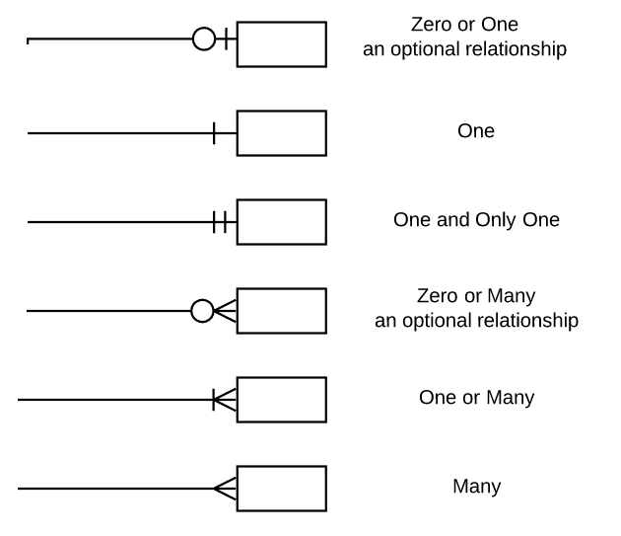

Relationships
A relationship is the association that describes the interaction between entities.
Cardinality refers to the number of instances of one entity that are associated with an instance of another entity.
In general, there may be one-to-one, one-to-many, or many-to-many relationships.
Ordinality relates to whether an entity is mandatory or optional with another associated entity.

Slide 6
Relationships
Description of the relationship between two entities
Verbs are expected here
Can either have a label at either end or one with a “/” separating
  “Can contain / is on”
  OR
  Can contain is on
  Reads from parent to child (one to many) or left to right, top to bottom

Slide 7
Attributes
Also known as a column, an attribute is a property or characteristic that describes the entity that holds it.
A primary key, also known as PK, is a special kind of entity attribute that uniquely defines a record in a database table. In other words, there must not be two (or more) records that share the same value for the primary key attribute.
  PK must be Unique, Stable, and NOT NULL.
A foreign key, also known as FK, is a reference to a primary key in a table. It is used to identify the relationships between entities. Note that foreign keys need not be unique. Multiple records can share the same values.
Must list mentioned ones from specs and need to have at least 3 per entity

Slide 8
Steps involved in creating an ERD include:
Identifying and defining the entities
Determining all interactions between the entities
Analyzing the nature of interactions/determining the cardinality of the relationships
Determining the attributes of each entity
Creating the ERD

Slide 9
Example
Employee
  Is part of one department
  Must belong to a department
  May or may not have a manager
  Can have 0 or many employee reviews – depending on their length of service
Department
  Can have many employees
  Must have at least one employee to be considered a department
  A department with more than 3 employees must have a manager
Manager
  Can manage more than one department
  Has employees
  Creates yearly performance review for every employee
Employee review
  Must be associated to an employee
  Is created by a manager

Slide 10
Example

Slide 11
Thank you
Prepared by Maryanne Doucette
Last updated 2/22/20
References
  Techopedia - https://www.techopedia.com/definition/1200/entity-relationship-diagram-erd
  Visual Paradigm, What is Entity Relationship Diagram (ERD); https://www.visual-paradigm.com/guide/data-modeling/what-is-entity-relationship-diagram/

